Slide 1
Interface design

Slide 2
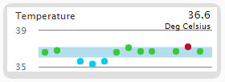
Some information is displayed in a temporal manner:
vital sign measurements
medication administration
laboratory test results
ventilator settings
intake and output measurements
Most recent value
Data field name
Units of the most recent value
Reference range (blue band)
Y-Axis ranges
Data point (in this case, a temperature measurement)
Red data point: above reference range
Green data point: within reference range
Blue data point: below reference range
Time increases from left to right

Slide 3
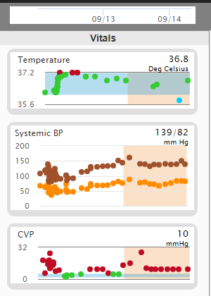
Date axis
For blood pressure charts:
systolic measurements are brown
diastolic measurements are orange
The tan band covers the last 24 hours of patient data

Slide 4
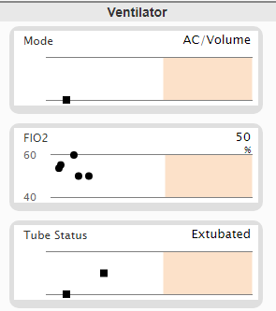
Discrete data points are represented with black squares
Data points on a chart without a blue reference range are black circles
Discrete data points with different y-axis height will have different values. Points with the same y-axis height will have the same value
Discrete data fields do not have a defined y-axis. Hover over a data point with curser to see value (shown on next slide)

Slide 5
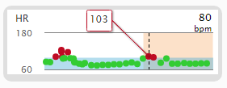

Hover over data point with curser to see value

Slide 6
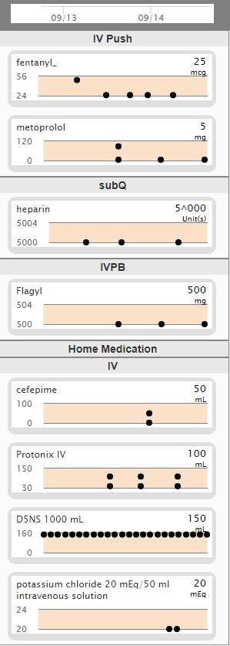
Medication charts will follow the same rules as other charts. Data points provided correspond to medication administration. The data field names and data points displayed are based on the information we have access to in our database of de-identified patient cases. Make sense of it the best you can.
Meds are grouped by route
Some charts will display both volume and mass. Hover over the points to see the difference.

Slide 7
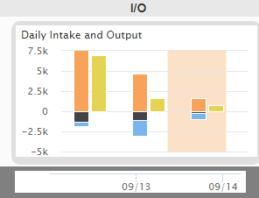
Intake and output uses a bar chart where there are two bars for each day. A multi-color bar that shows the differed types of measured intake and output and a yellow bar that shows the daily net. Hover over a bar to see the name of that type of i/o and the value of the measurement.

Slide 8
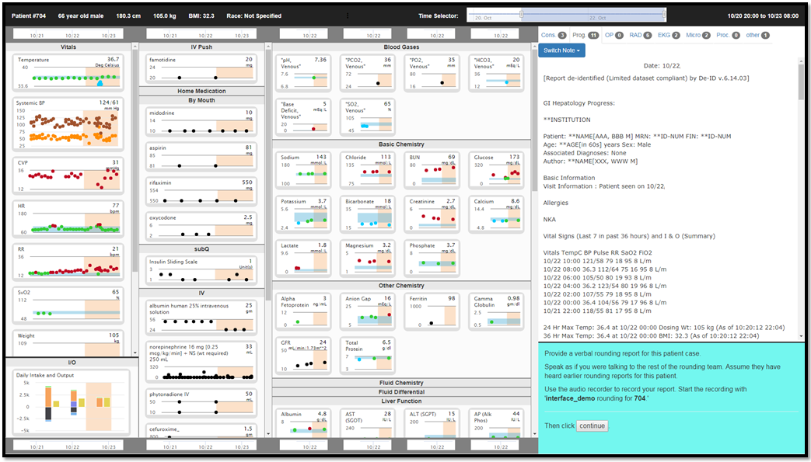
Demographics
Time range currently displayed across all data fields
Vitals and vent settings
Medications
(grouped
by route)
Laboratory test results
(grouped by type)
Free text data:
Notes, reports, & procedures
(grouped by tabs)
ICU Admission
Current time
Slide to change displayed range
Your tasks and navigation
Intake/output

Slide 9
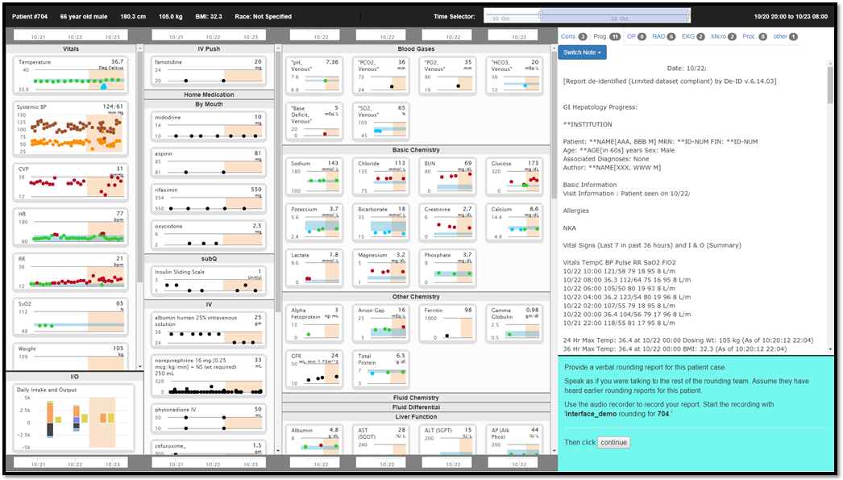
Time range currently displayed across all data fields
Free text data:
Notes, reports, & procedures
(grouped by tabs)
Time axis on top and bottom of each column
Your tasks and navigation
Each section scrolls

Slide 10
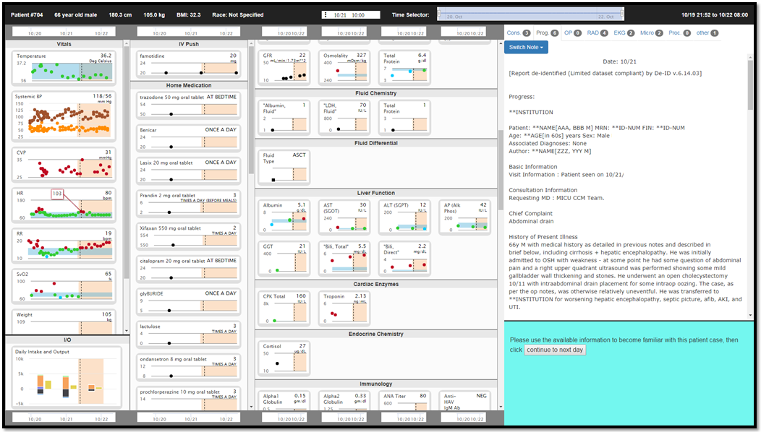
Time range currently displayed across all data fields
By default, the free text note will be a progress note from the prior day.

Slide 11
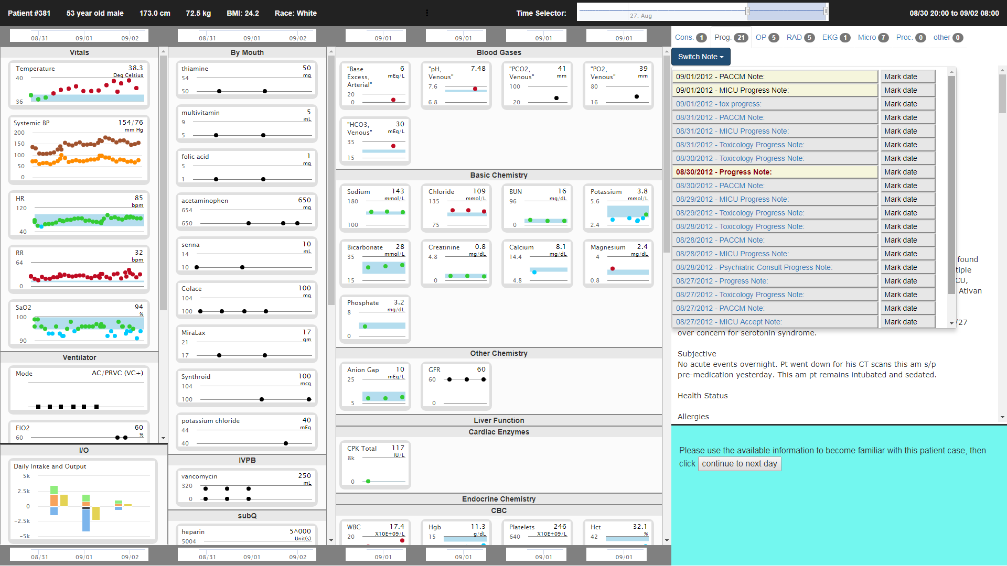
Time range currently displayed across all data fields
To switch between progress notes, click the switch note button, then select a note
The current displayed note will have red bold letters
Notes that you have already seen (clicked on) will have a yellow background
If you click the mark date button…see next slide

Slide 12
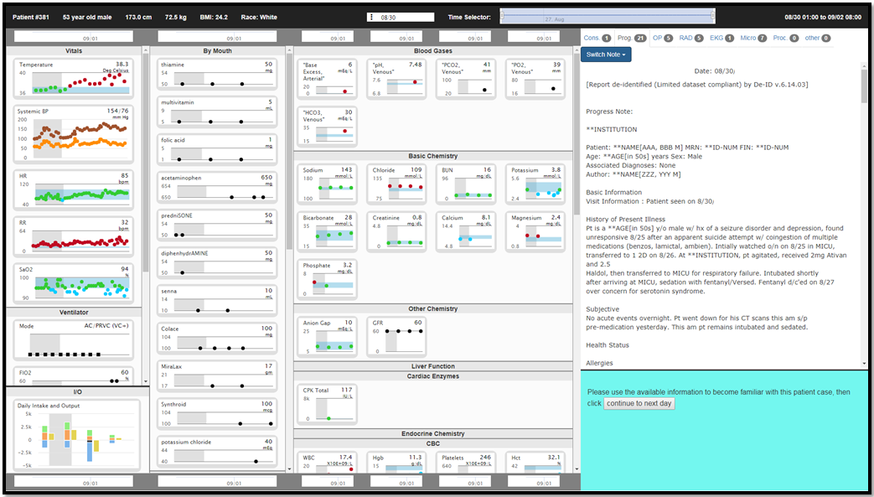
Time range currently displayed across all data fields
Mark date button will add a grey bar to all charts at the date the note was created.
If the date of note creation is not within the selected time range, the range will be automatically widened to include that date.

Slide 13
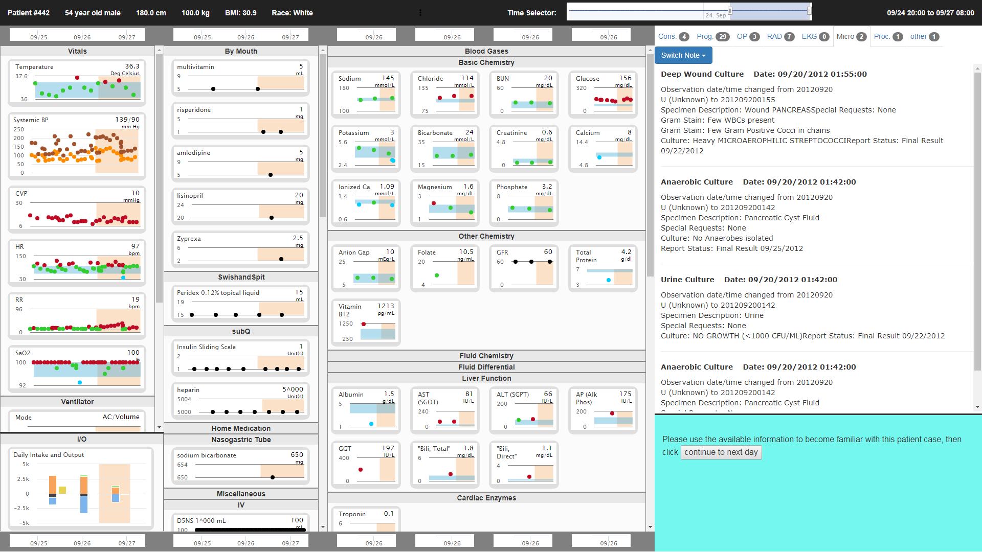
Time range currently displayed across all data fields
Use tabs to switch between consult notes, progress notes, operative notes, radiology reports, EKG reports, microbiology reports, procedures, and other (less common) note/report types
When you switch free text tabs, grey (mark date) bands will be removed
This is a microbiology report

Slide 14
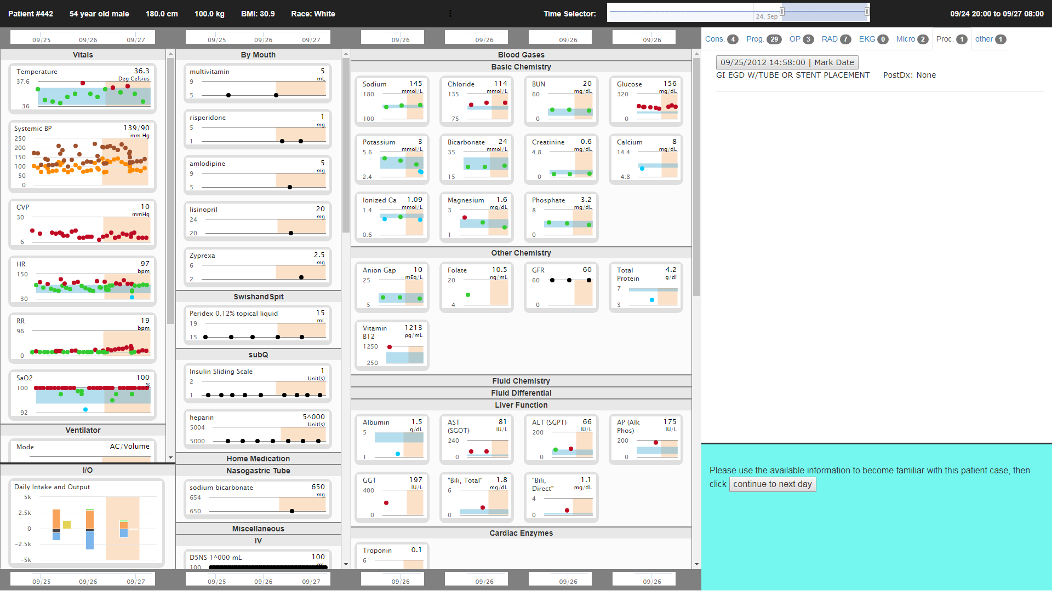
Time range currently displayed across all data fields
This is the procedure page. Procedures are listed in reverse chronological order.

Slide 15
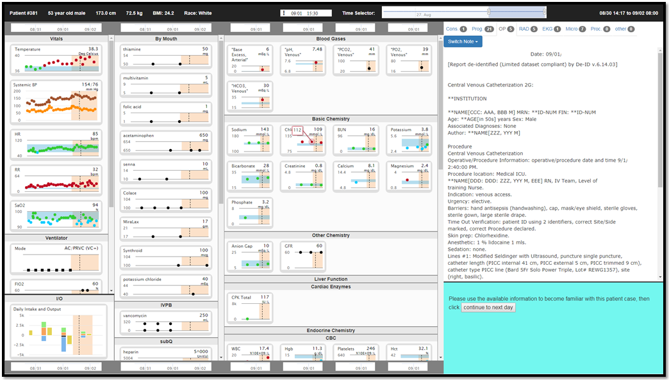
Time range currently displayed across all data fields
When you click on a data point
A black dotted line will appear at that timepoint on all of the charts
The date and time of that timepoint will display near the time selector.
To remove black dotted lines, switch free text tabs

Slide 16
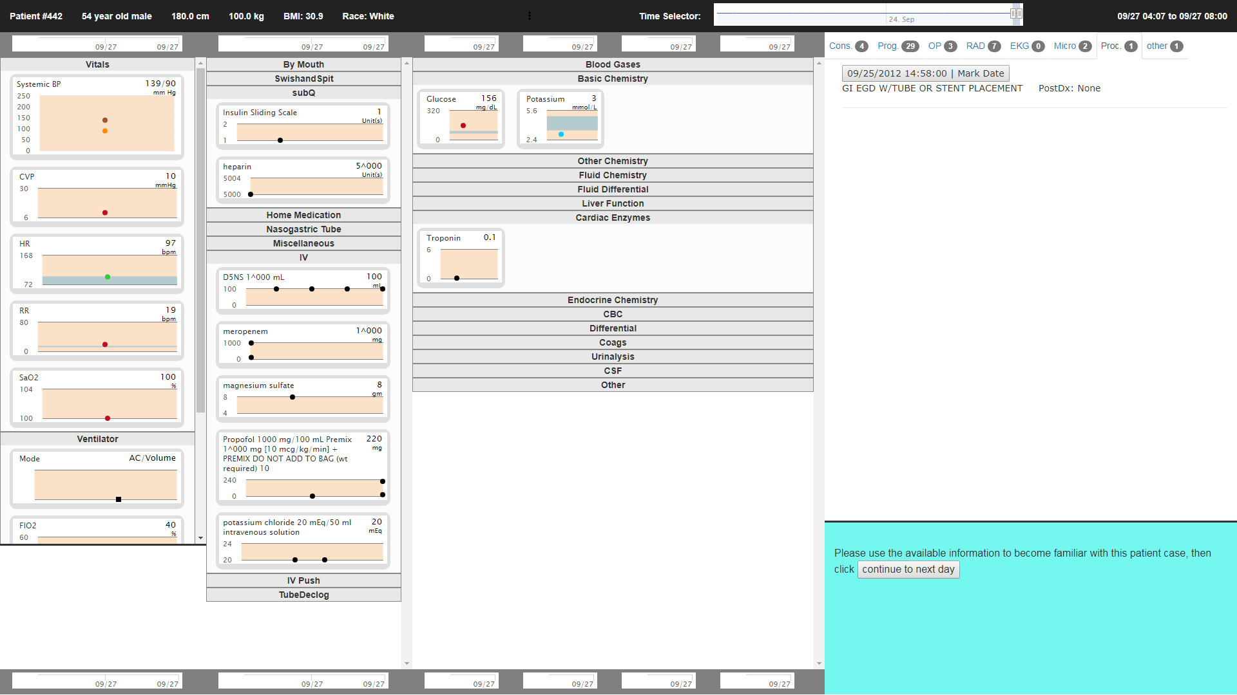
Time range currently displayed across all data fields
Whatever range is selected on the time selector will correspond to the time range displayed across all of the data field charts.
A small range will have few charts with data points present during that time. Drag one side of the time slider to increase the range and show more data fields.

Slide 17
Interface demo

Slide 18
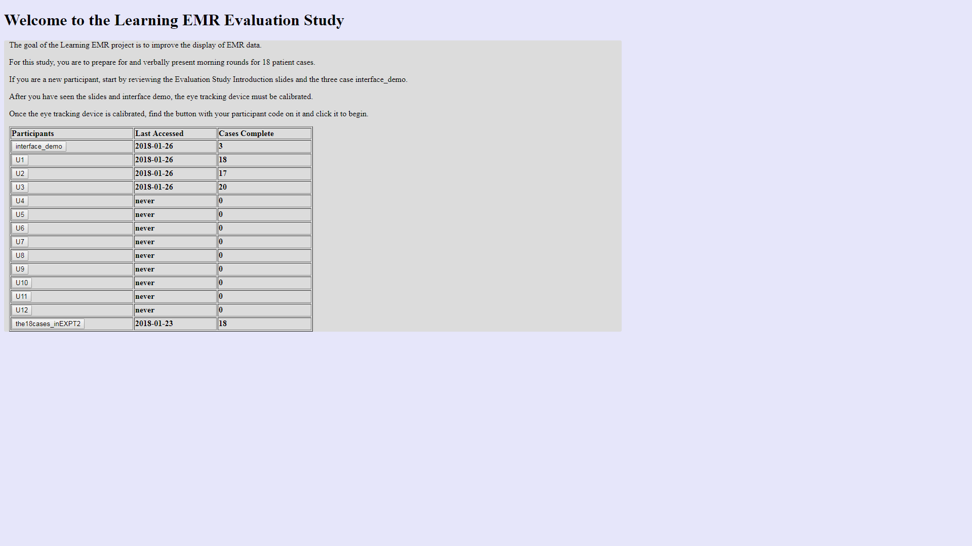
Study home screen
You have 18 cases to review
Click your participant ID to begin study

Slide 19

First you will see the eye tracker calibration screen
Eye tracker calibration: stare at the center of the red box while it is on screen. It will appear nine times.

Slide 20
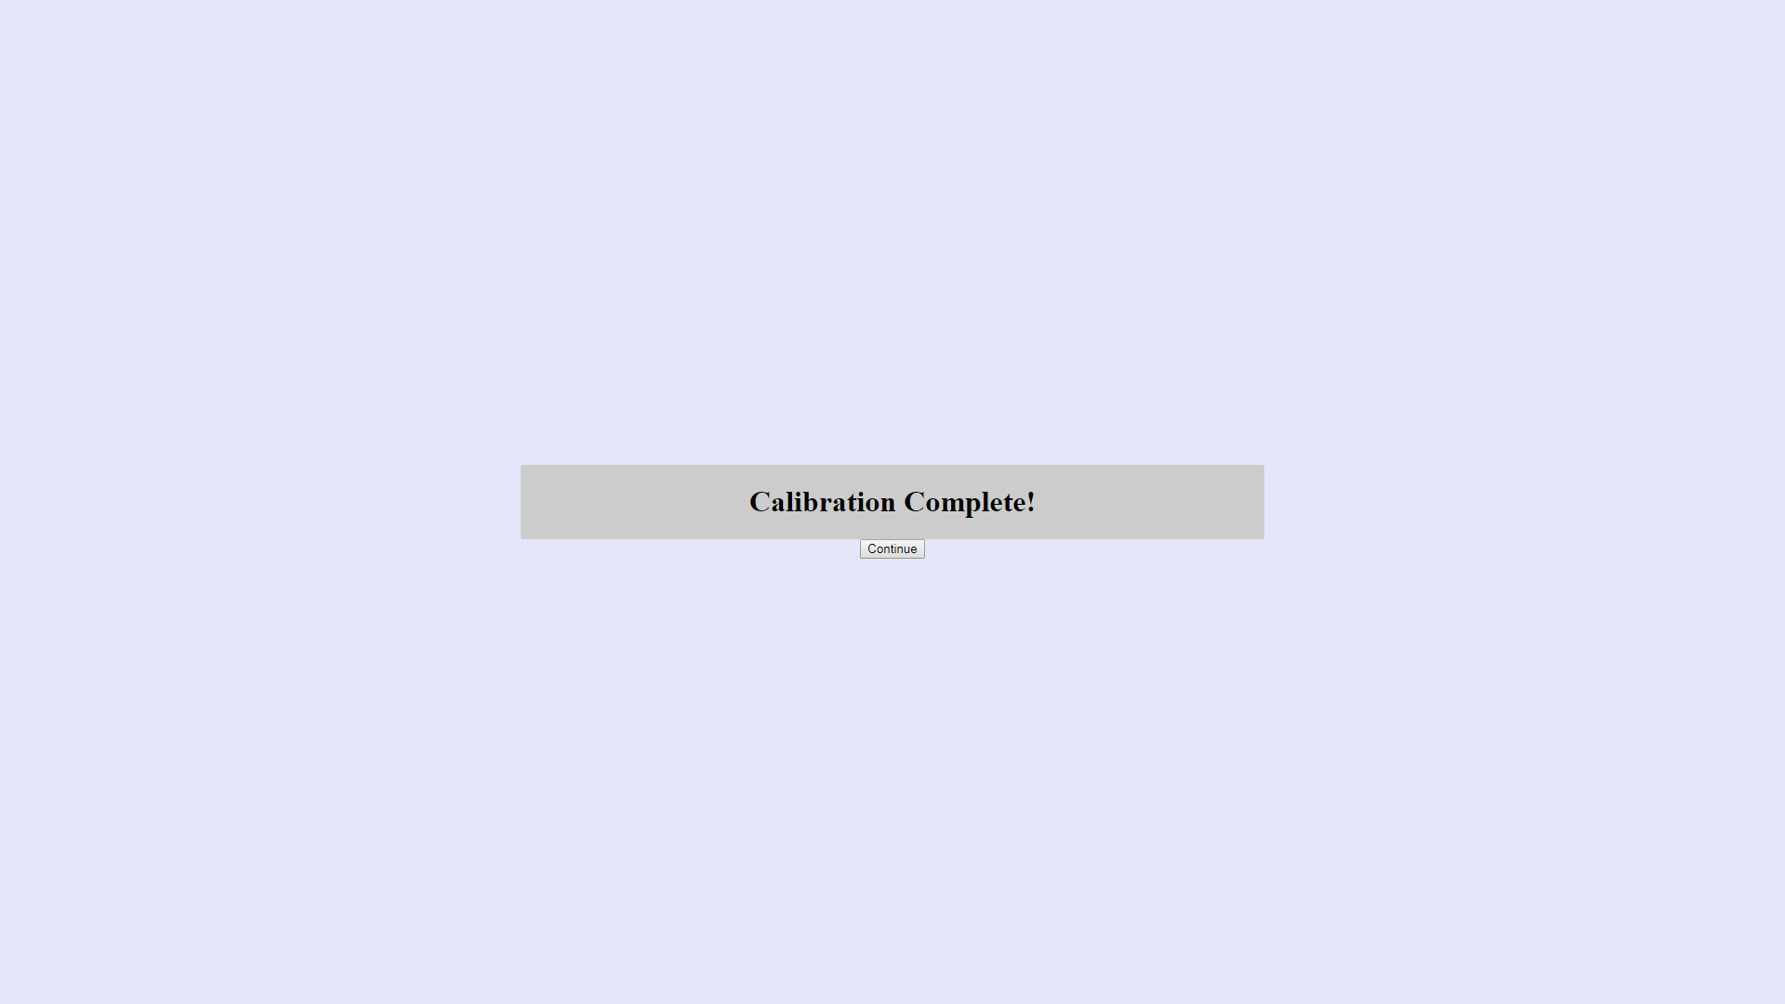
End of the eye tracker calibration screen
Click continue and you will go to your next case. There is a short delay after your click.

Slide 21
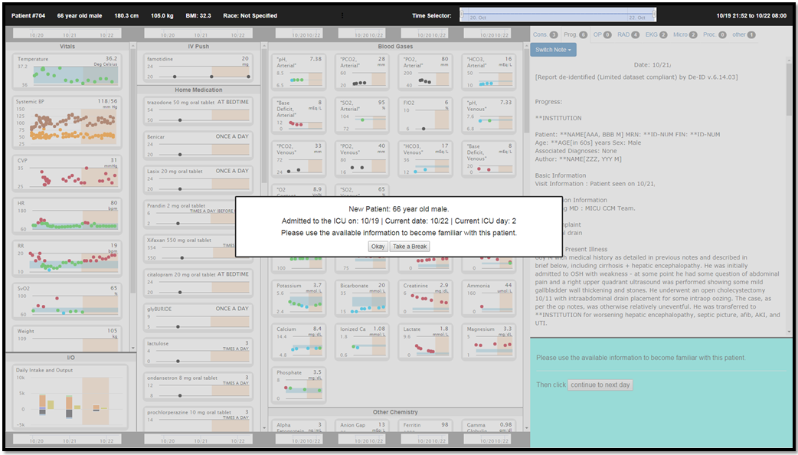
Demo Case 1 shown in Version 1
Remember the ICU admission date corresponds to the left side of the Time selector and the current date corresponds to the right side. By default, the most recent 72 hours will be selected for each case.
Click okay to start case. Take a Break will save your progress take you back to the home screen.

Slide 22
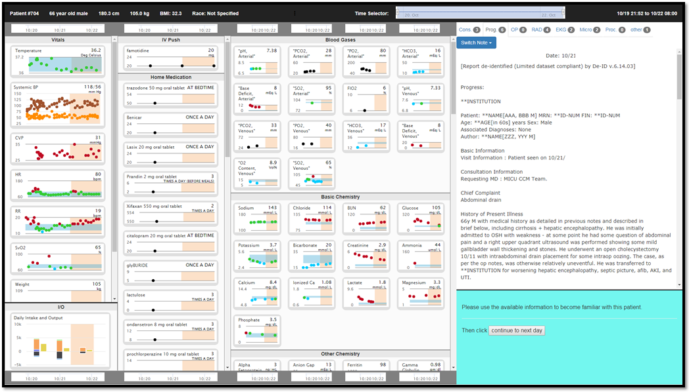
Demo Case 1 shown in Version 1
Task A.

Slide 23
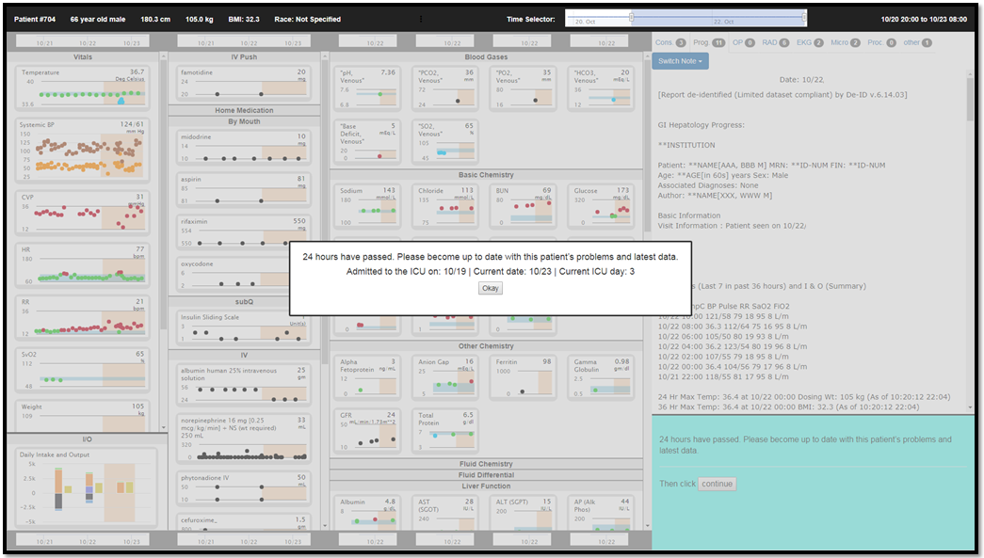
Demo Case 1 shown in Version 1
You can see 24 more hours are added to the time selector.
Default selected time still corresponds to the most recent 72 hours.

Slide 24

Demo Case 1 shown in Version 1
Task B.

Slide 25
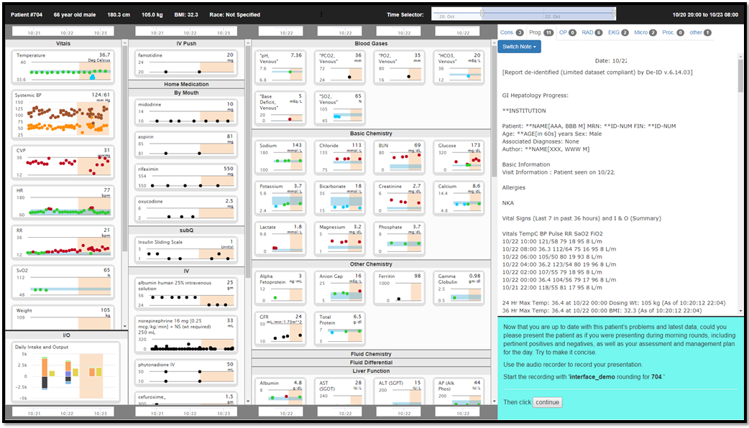
Demo Case 1 shown in Version 1
Task C.

Slide 26

Demo Case 1 shown in Version 1
Task D.

Slide 27
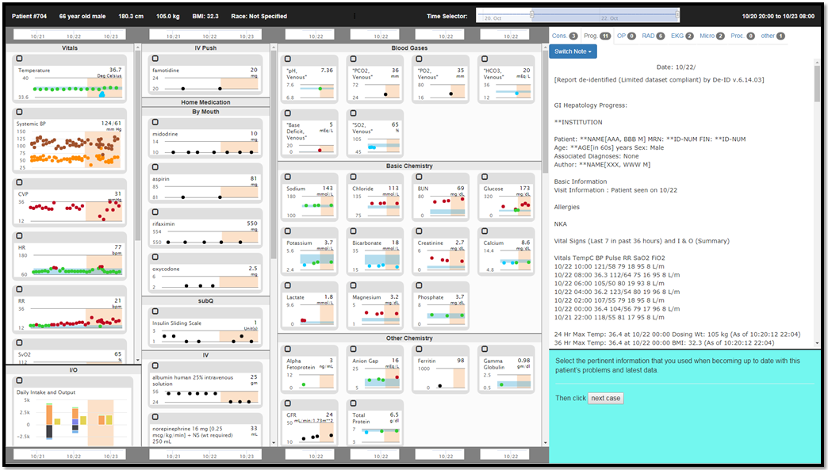
Demo Case 1 shown in Version 1
Task E.

Slide 28
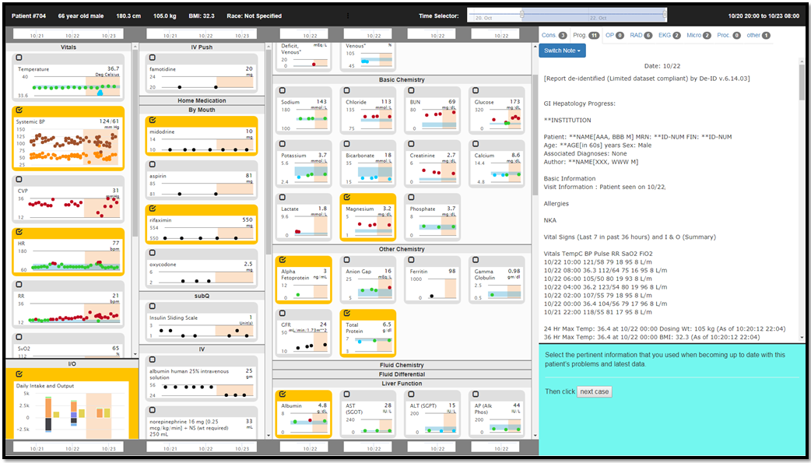
Demo Case 1 shown in Version 1
Task E. (with some selections being shown)

Slide 29
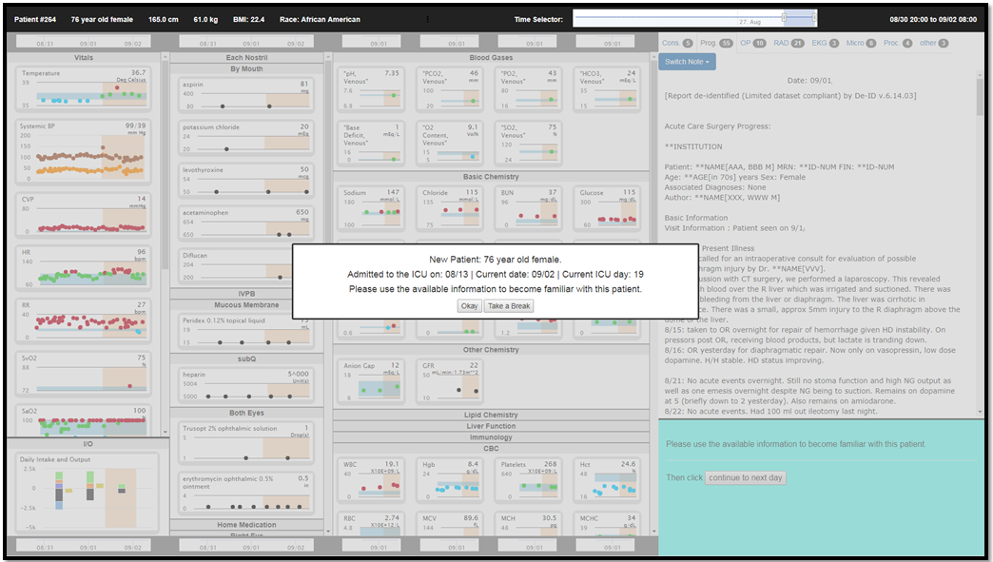
Demo Case 2 shown in Version 2

Slide 30
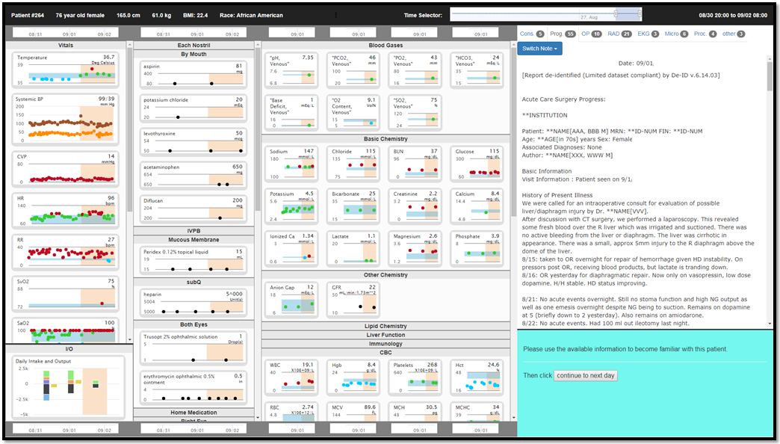
Demo Case 2 shown in Version 2
Task A.

Slide 31
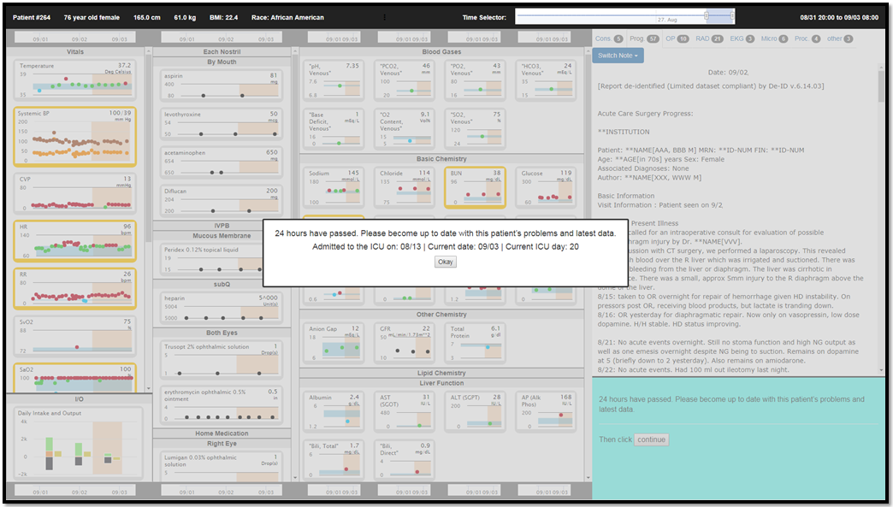
Demo Case 2 shown in Version 2

Slide 32
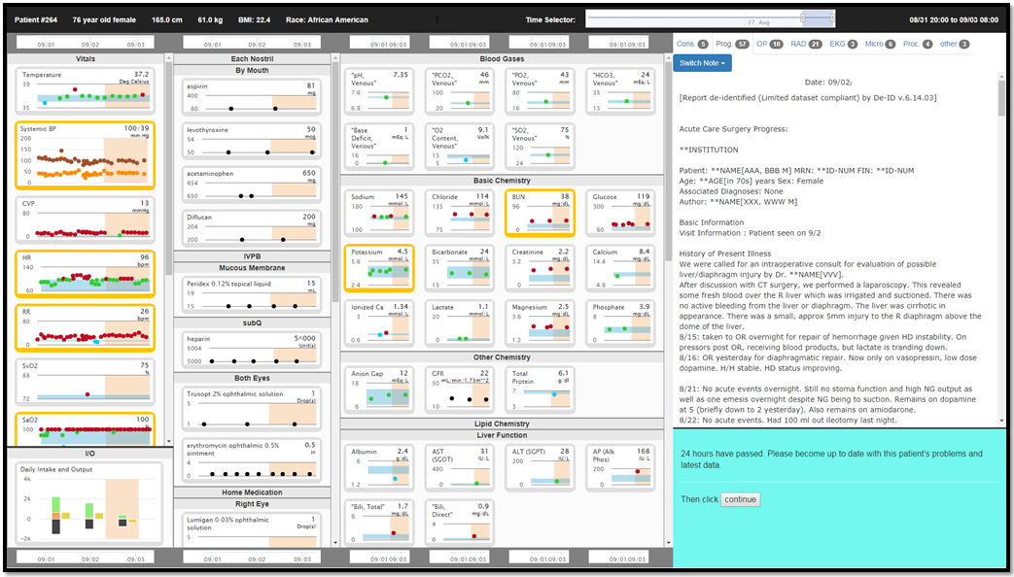
Demo Case 2 shown in Version 2
Version 2 differs from Version 1:
For Tasks B-E, some data fields will have a highlighted background.
No Task F.
Task B.

Slide 33
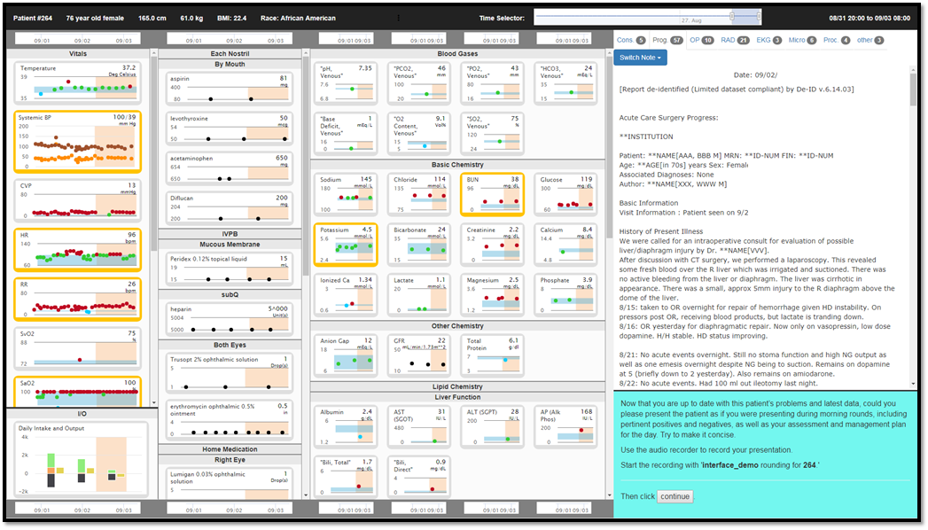
Demo Case 2 shown in Version 2
Task C.

Slide 34
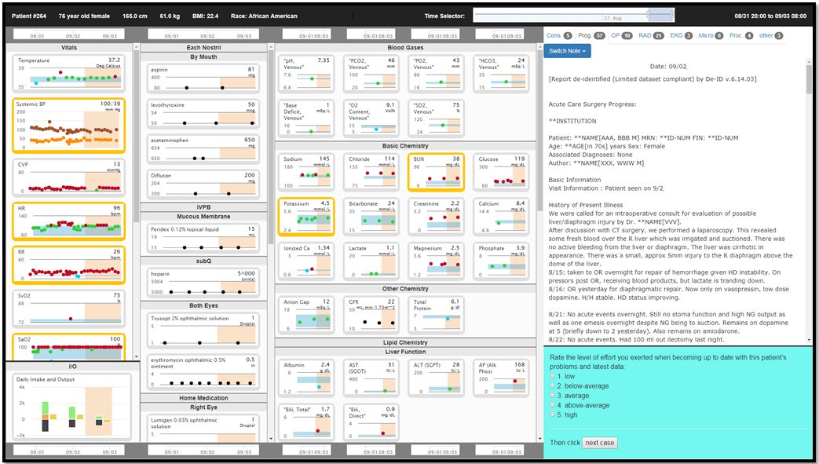
Demo Case 2 shown in Version 2
Task D.

Slide 35
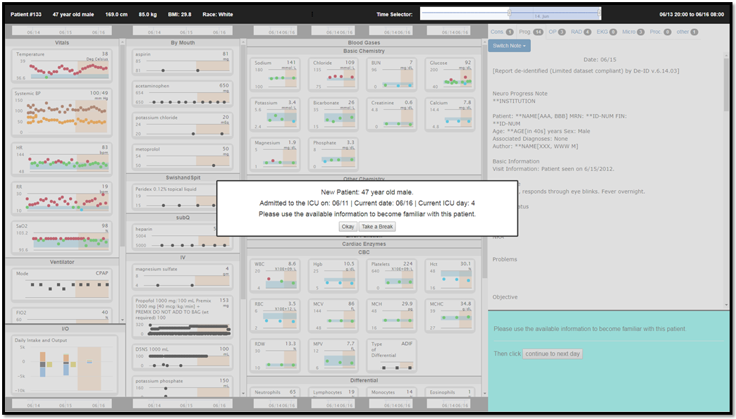
Demo Case 3 shown in Version 3

Slide 36
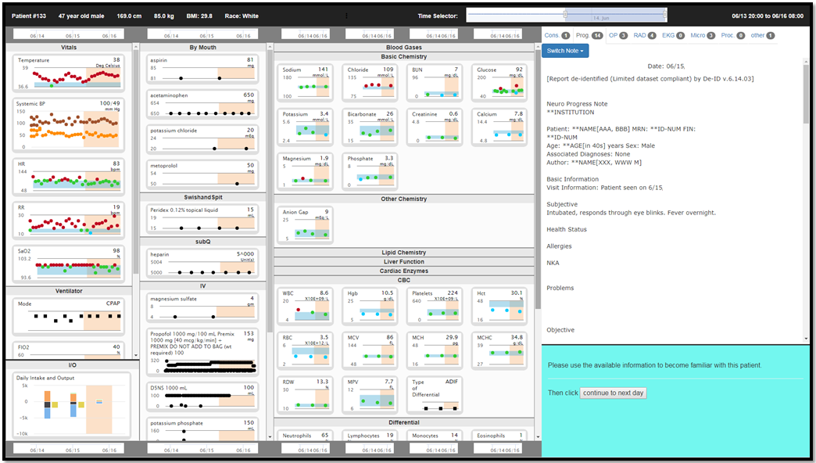
Demo Case 3 shown in Version 3
Task A.

Slide 37
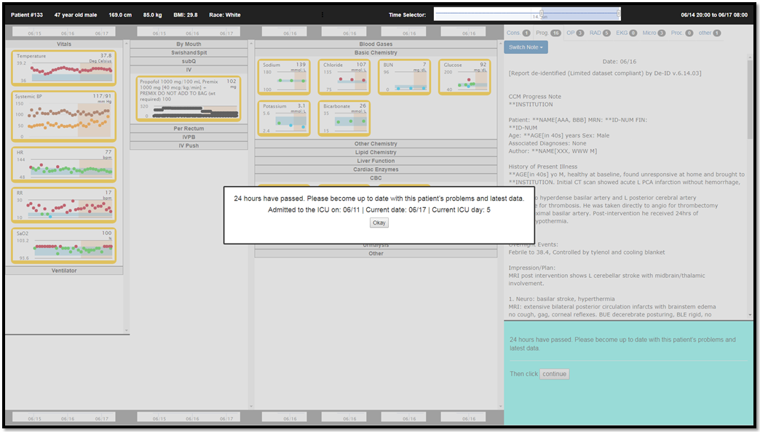
Demo Case 3 shown in Version 3

Slide 38
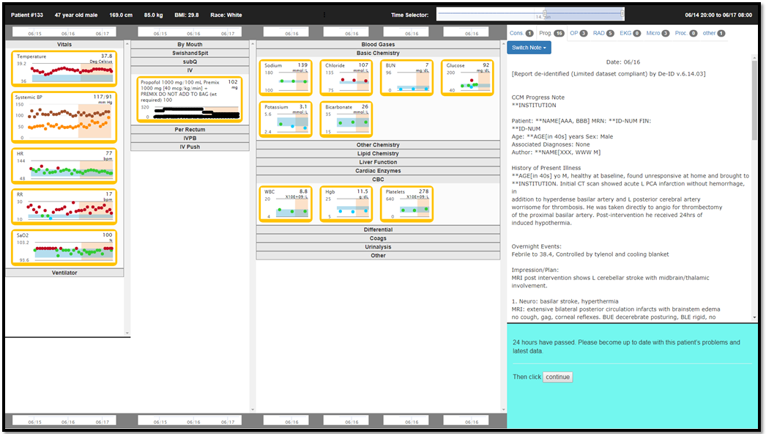
Demo Case 3 shown in Version 3
Version 3 differs from Versions 1 and 2:
For Tasks B-D, only data fields with a highlighted background will be displayed.
No Task E.
For Tasks F-G, all available data will be displayed.
Task B.

Slide 39
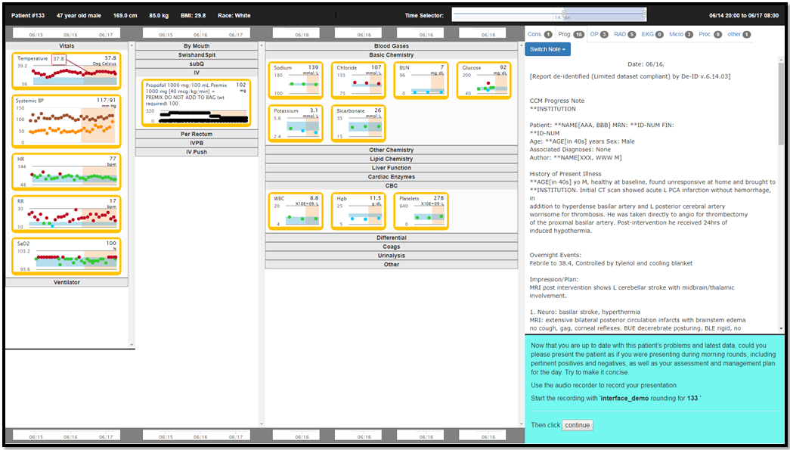
Demo Case 3 shown in Version 3
Task C.

Slide 40

Demo Case 3 shown in Version 3
Task D.

Slide 41
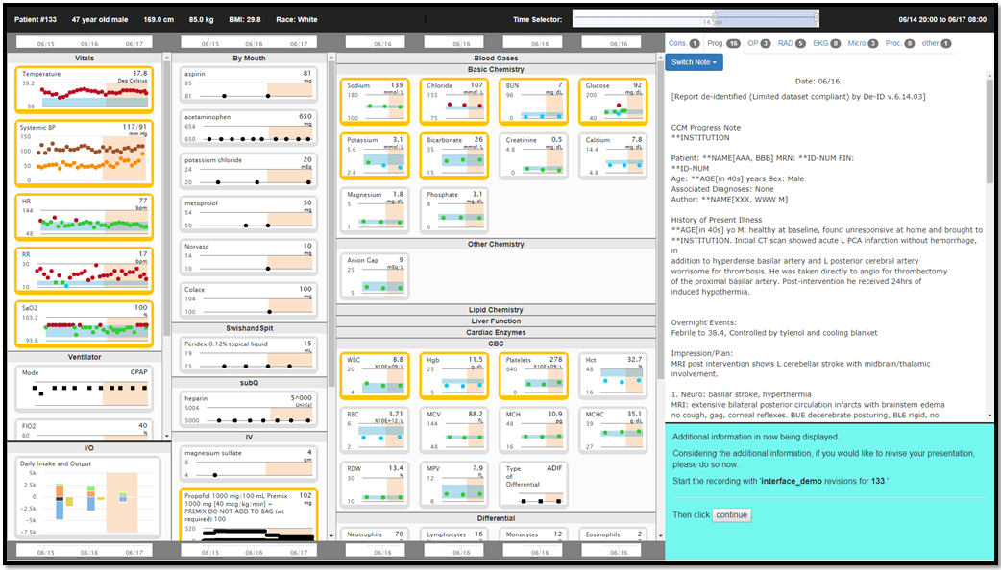
Demo Case 3 shown in Version 3
Task F. (no Task E in Version 3)

Slide 42
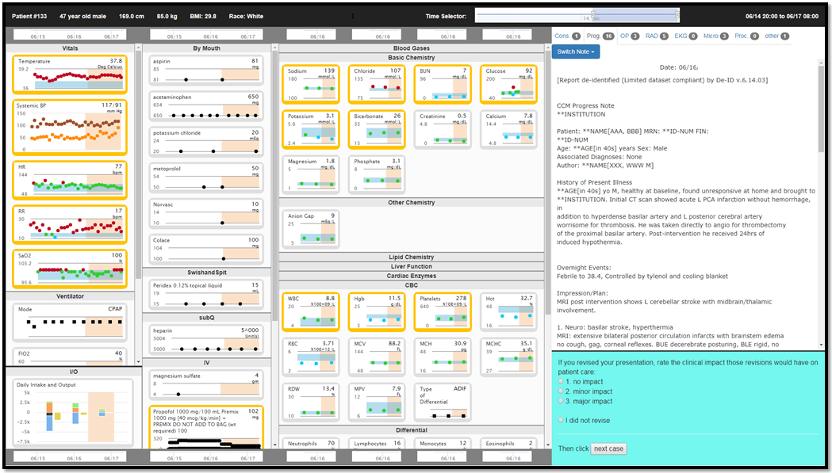
Demo Case 3 shown in Version 3
Task G.

Slide 43
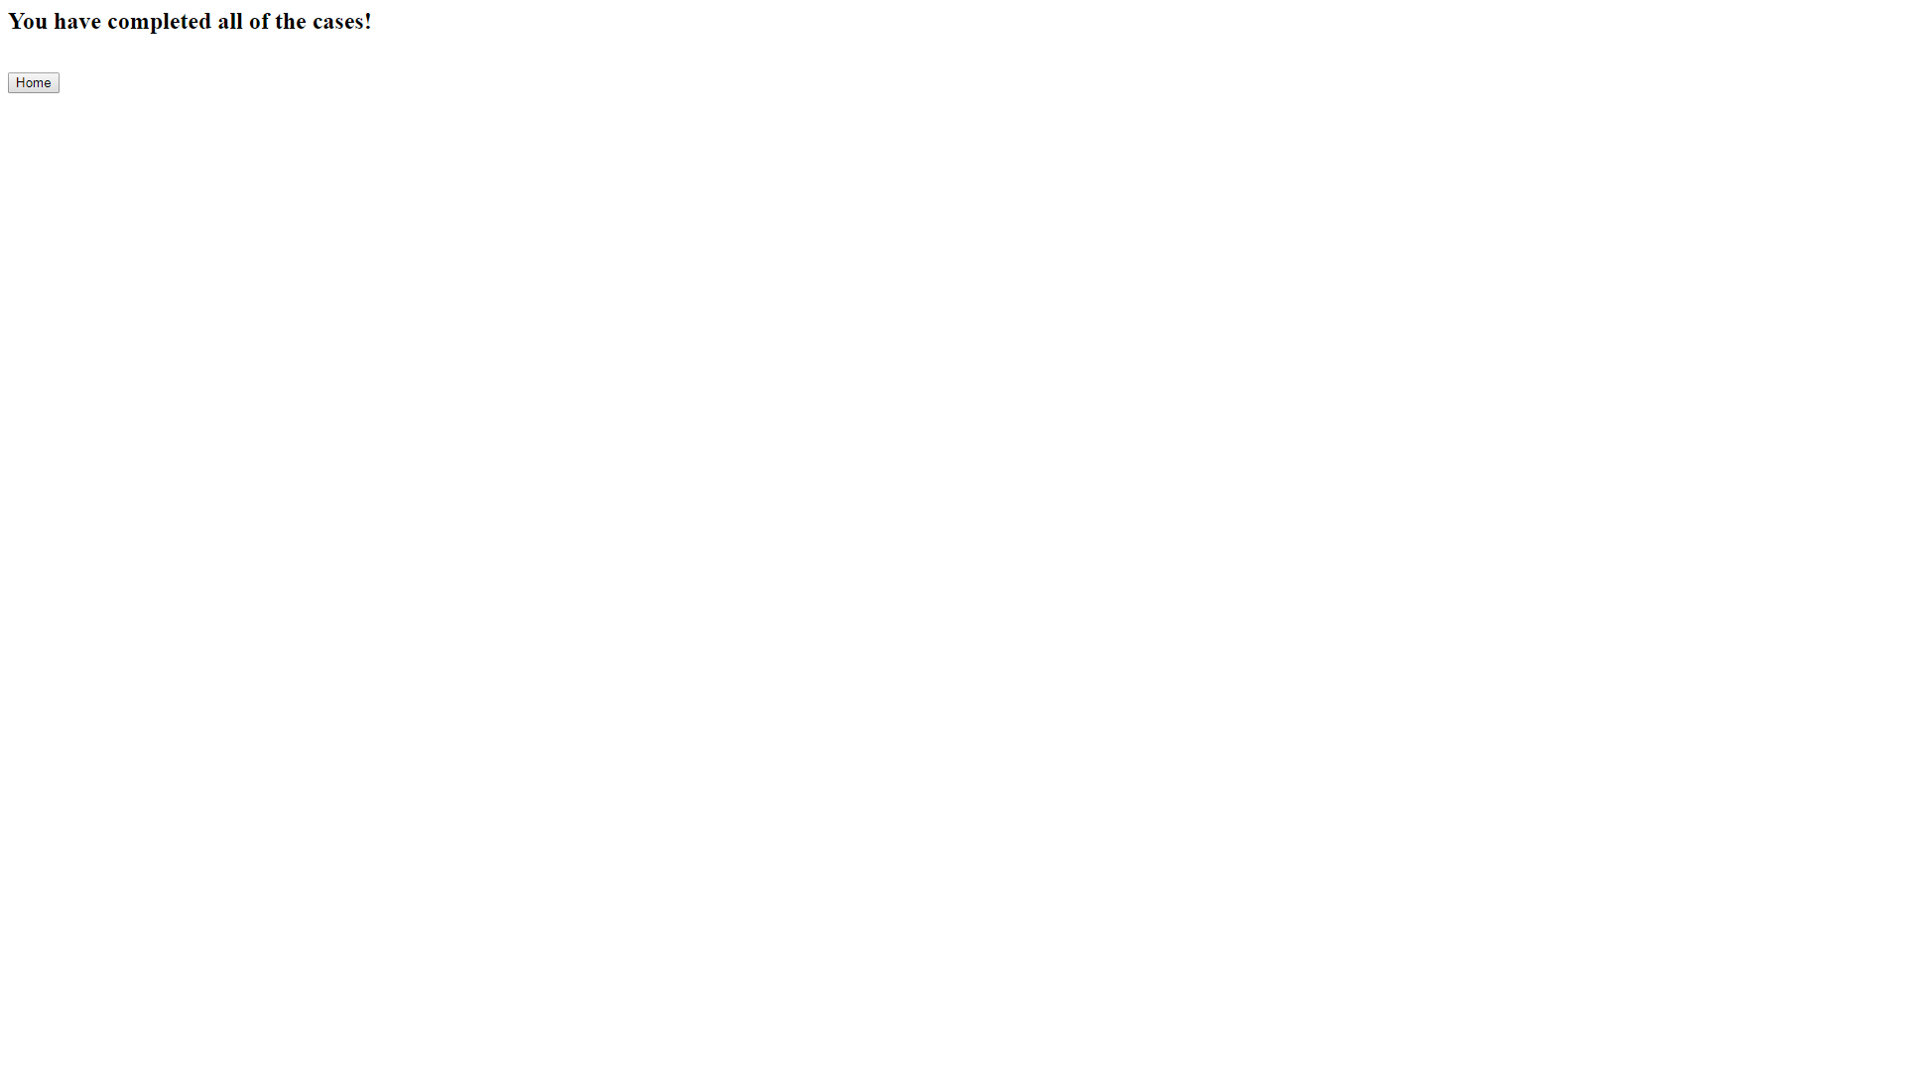
Study completed screen

